Slide 1
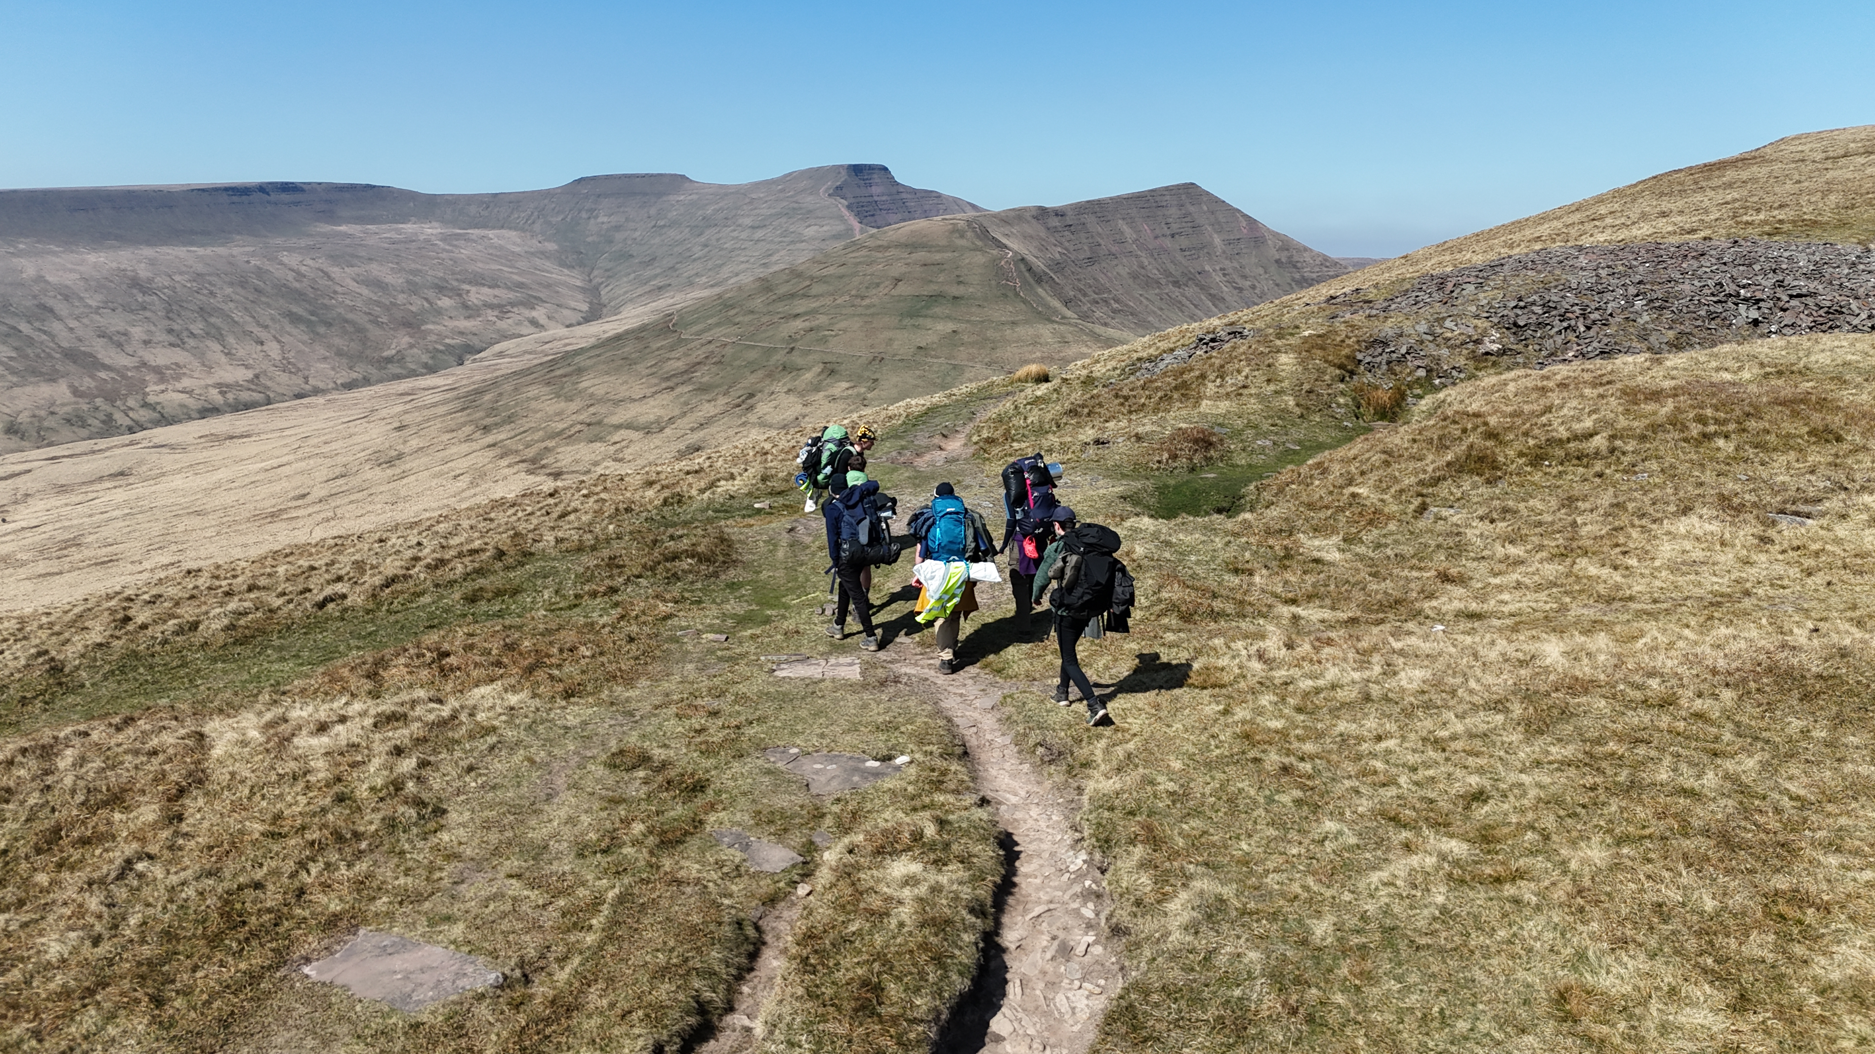




The Duke of Edinburgh’s Award Scheme Launch Evening

Slide 2
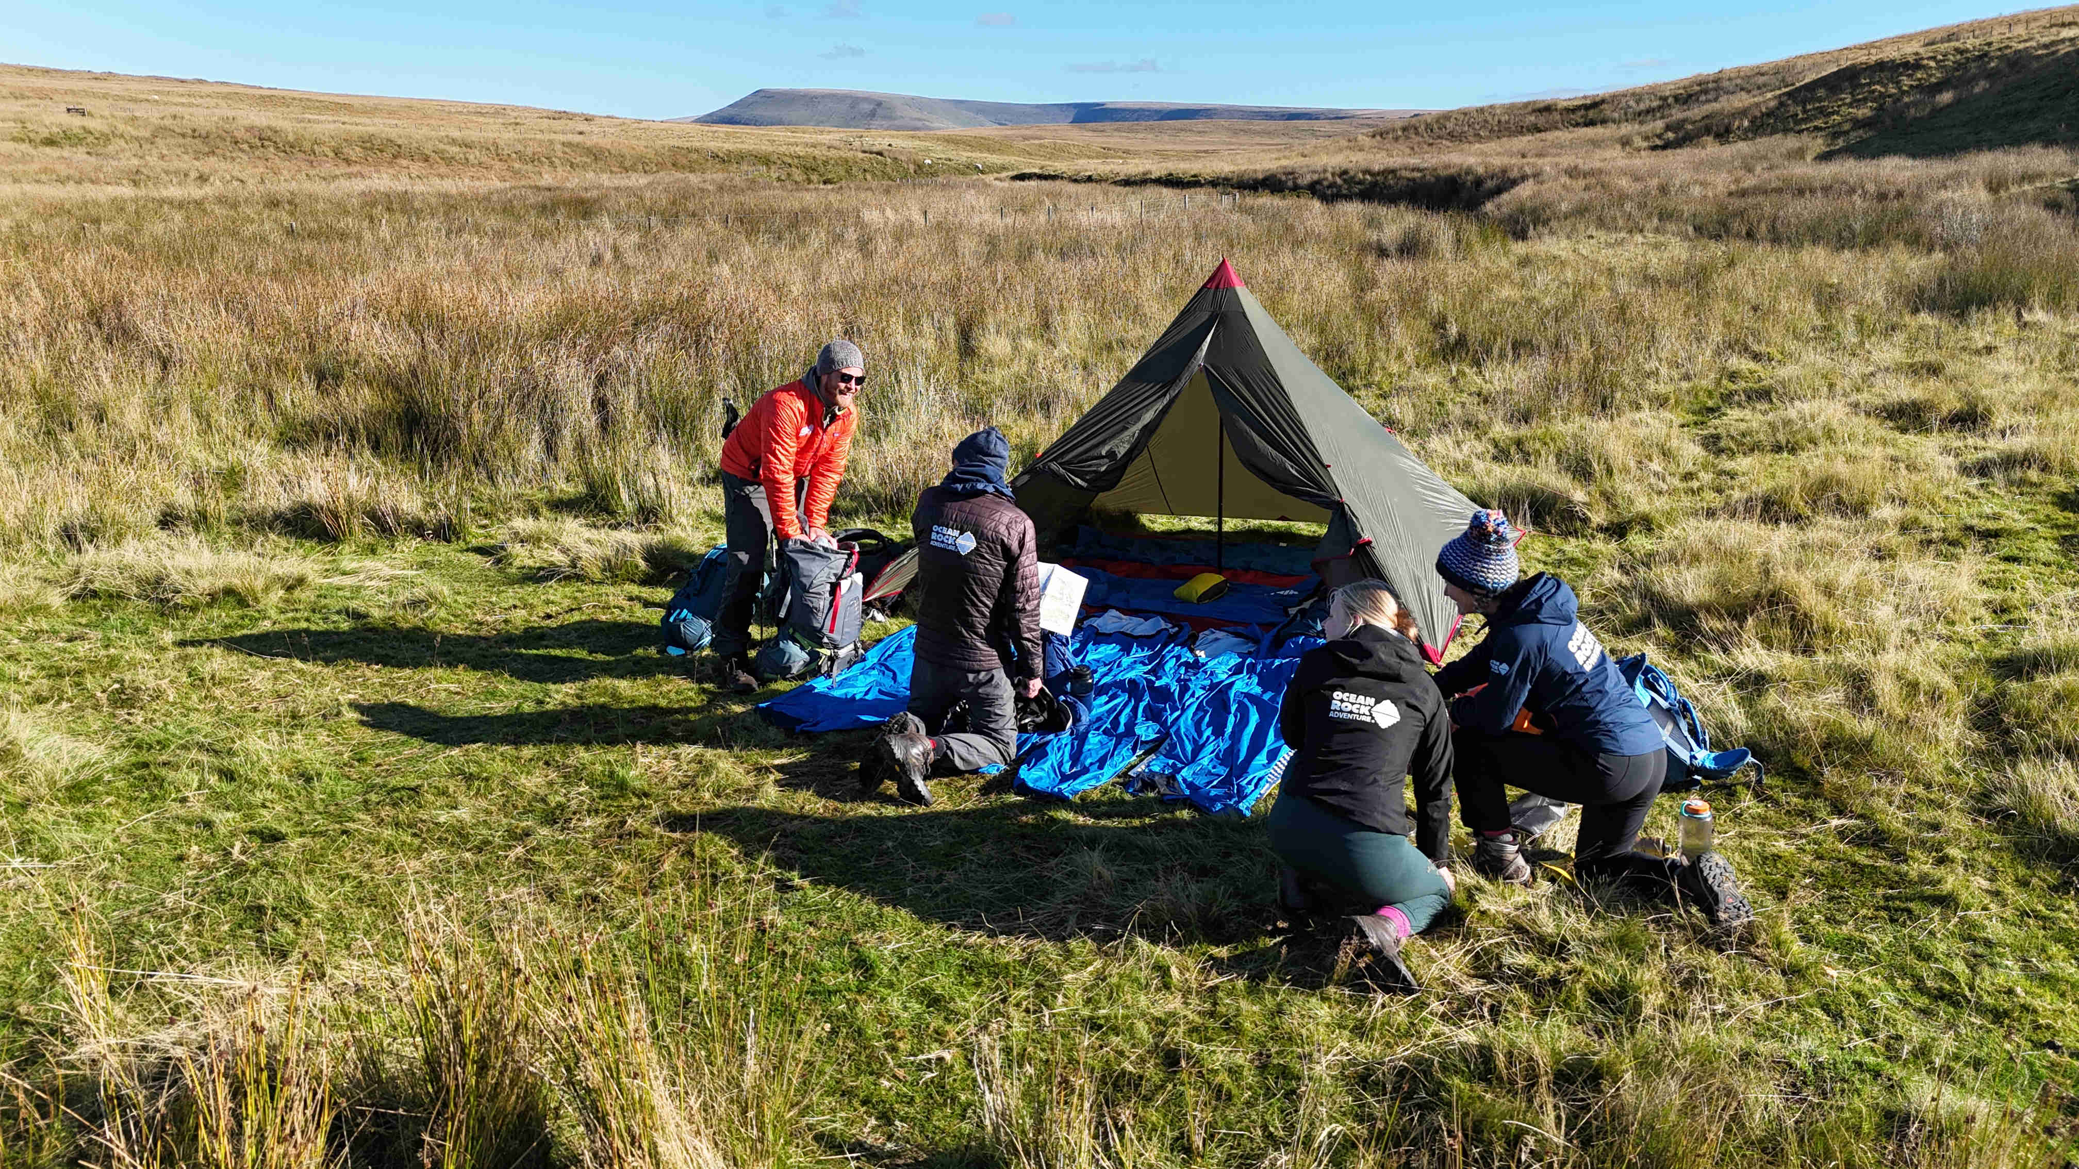
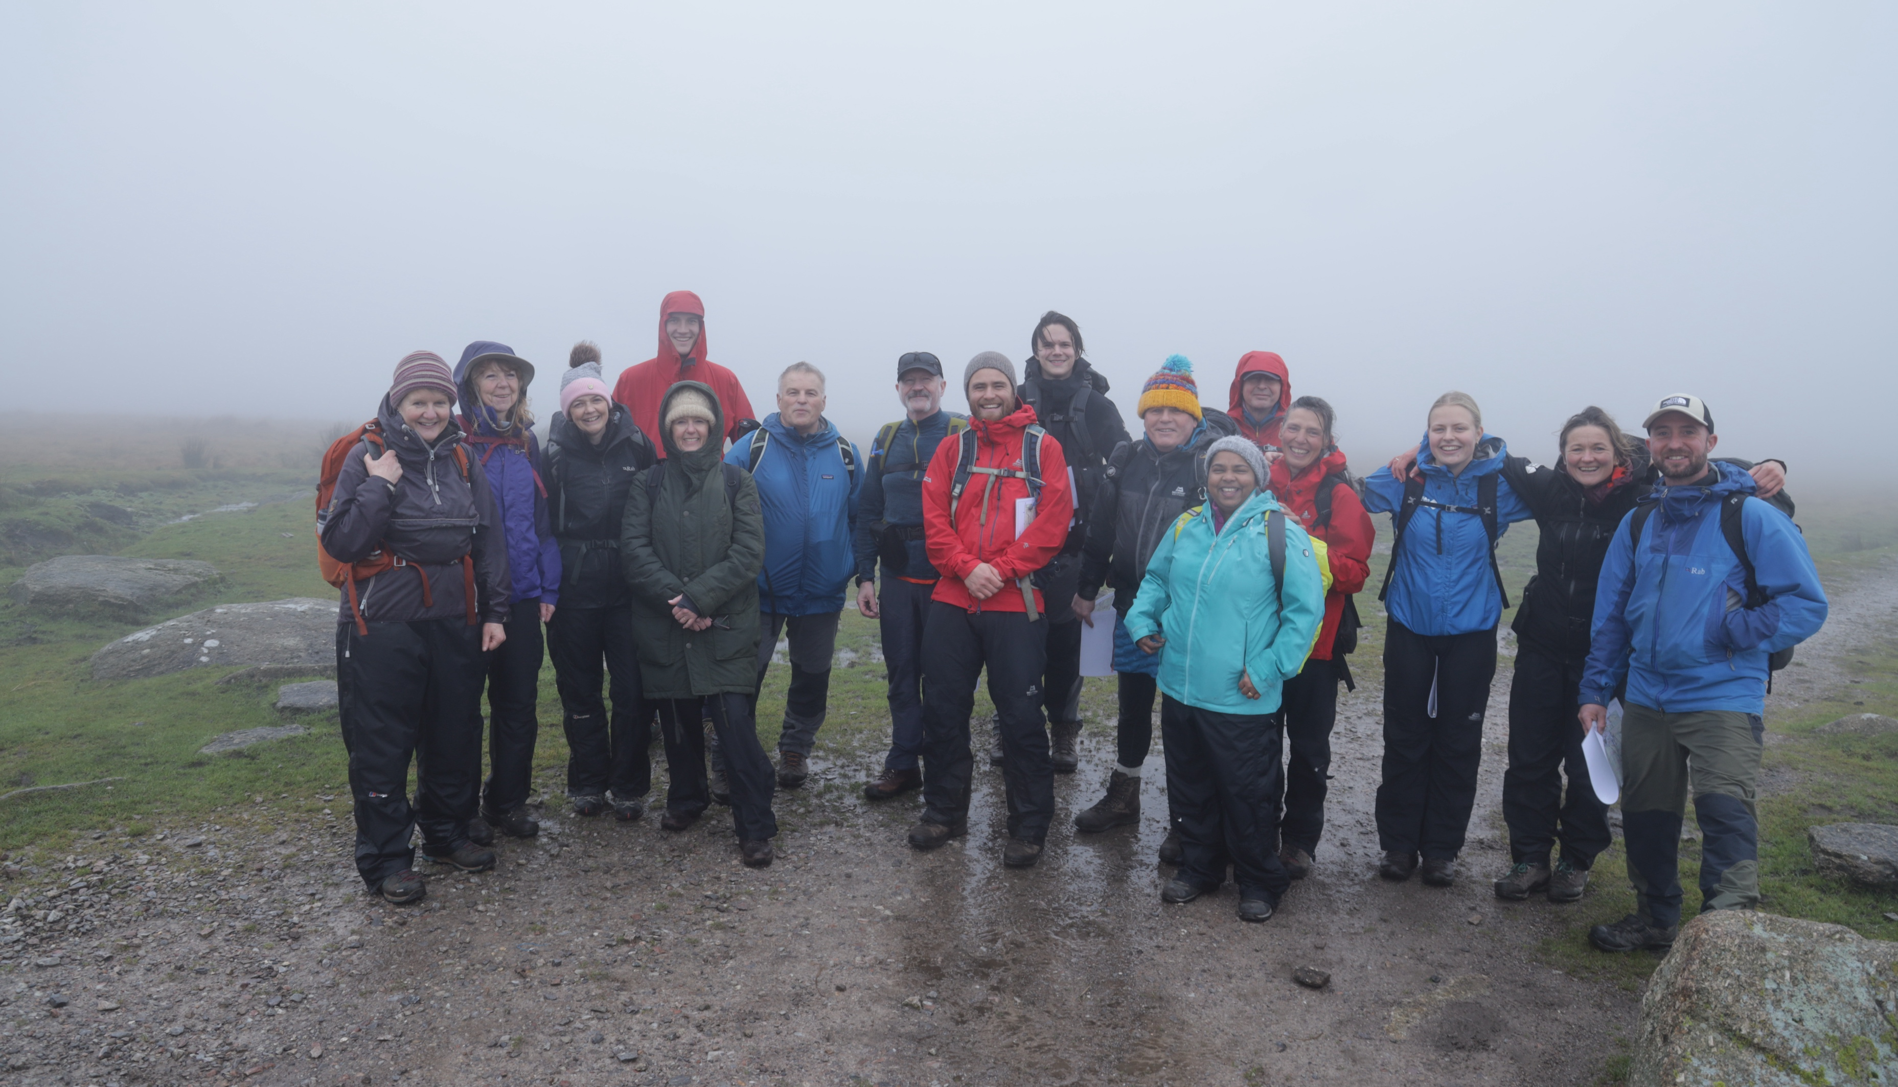
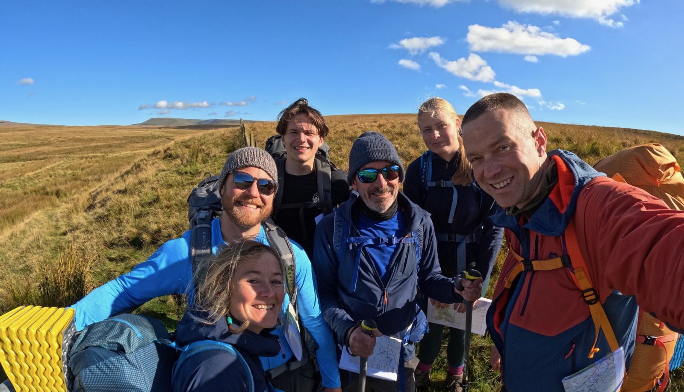
Who we are

Slide 3
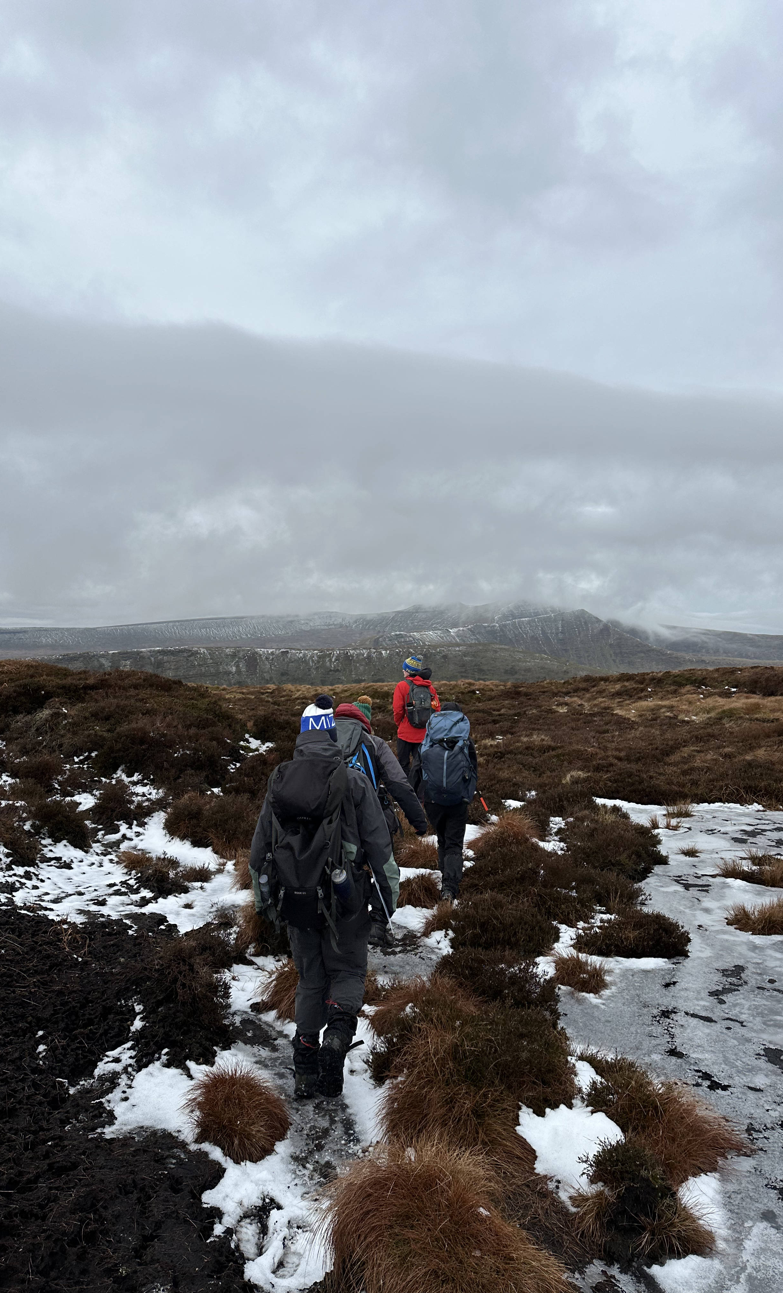

DofE
THE SPIRIT OF ADVENTURE!
Mountains and Moorland

Slide 4
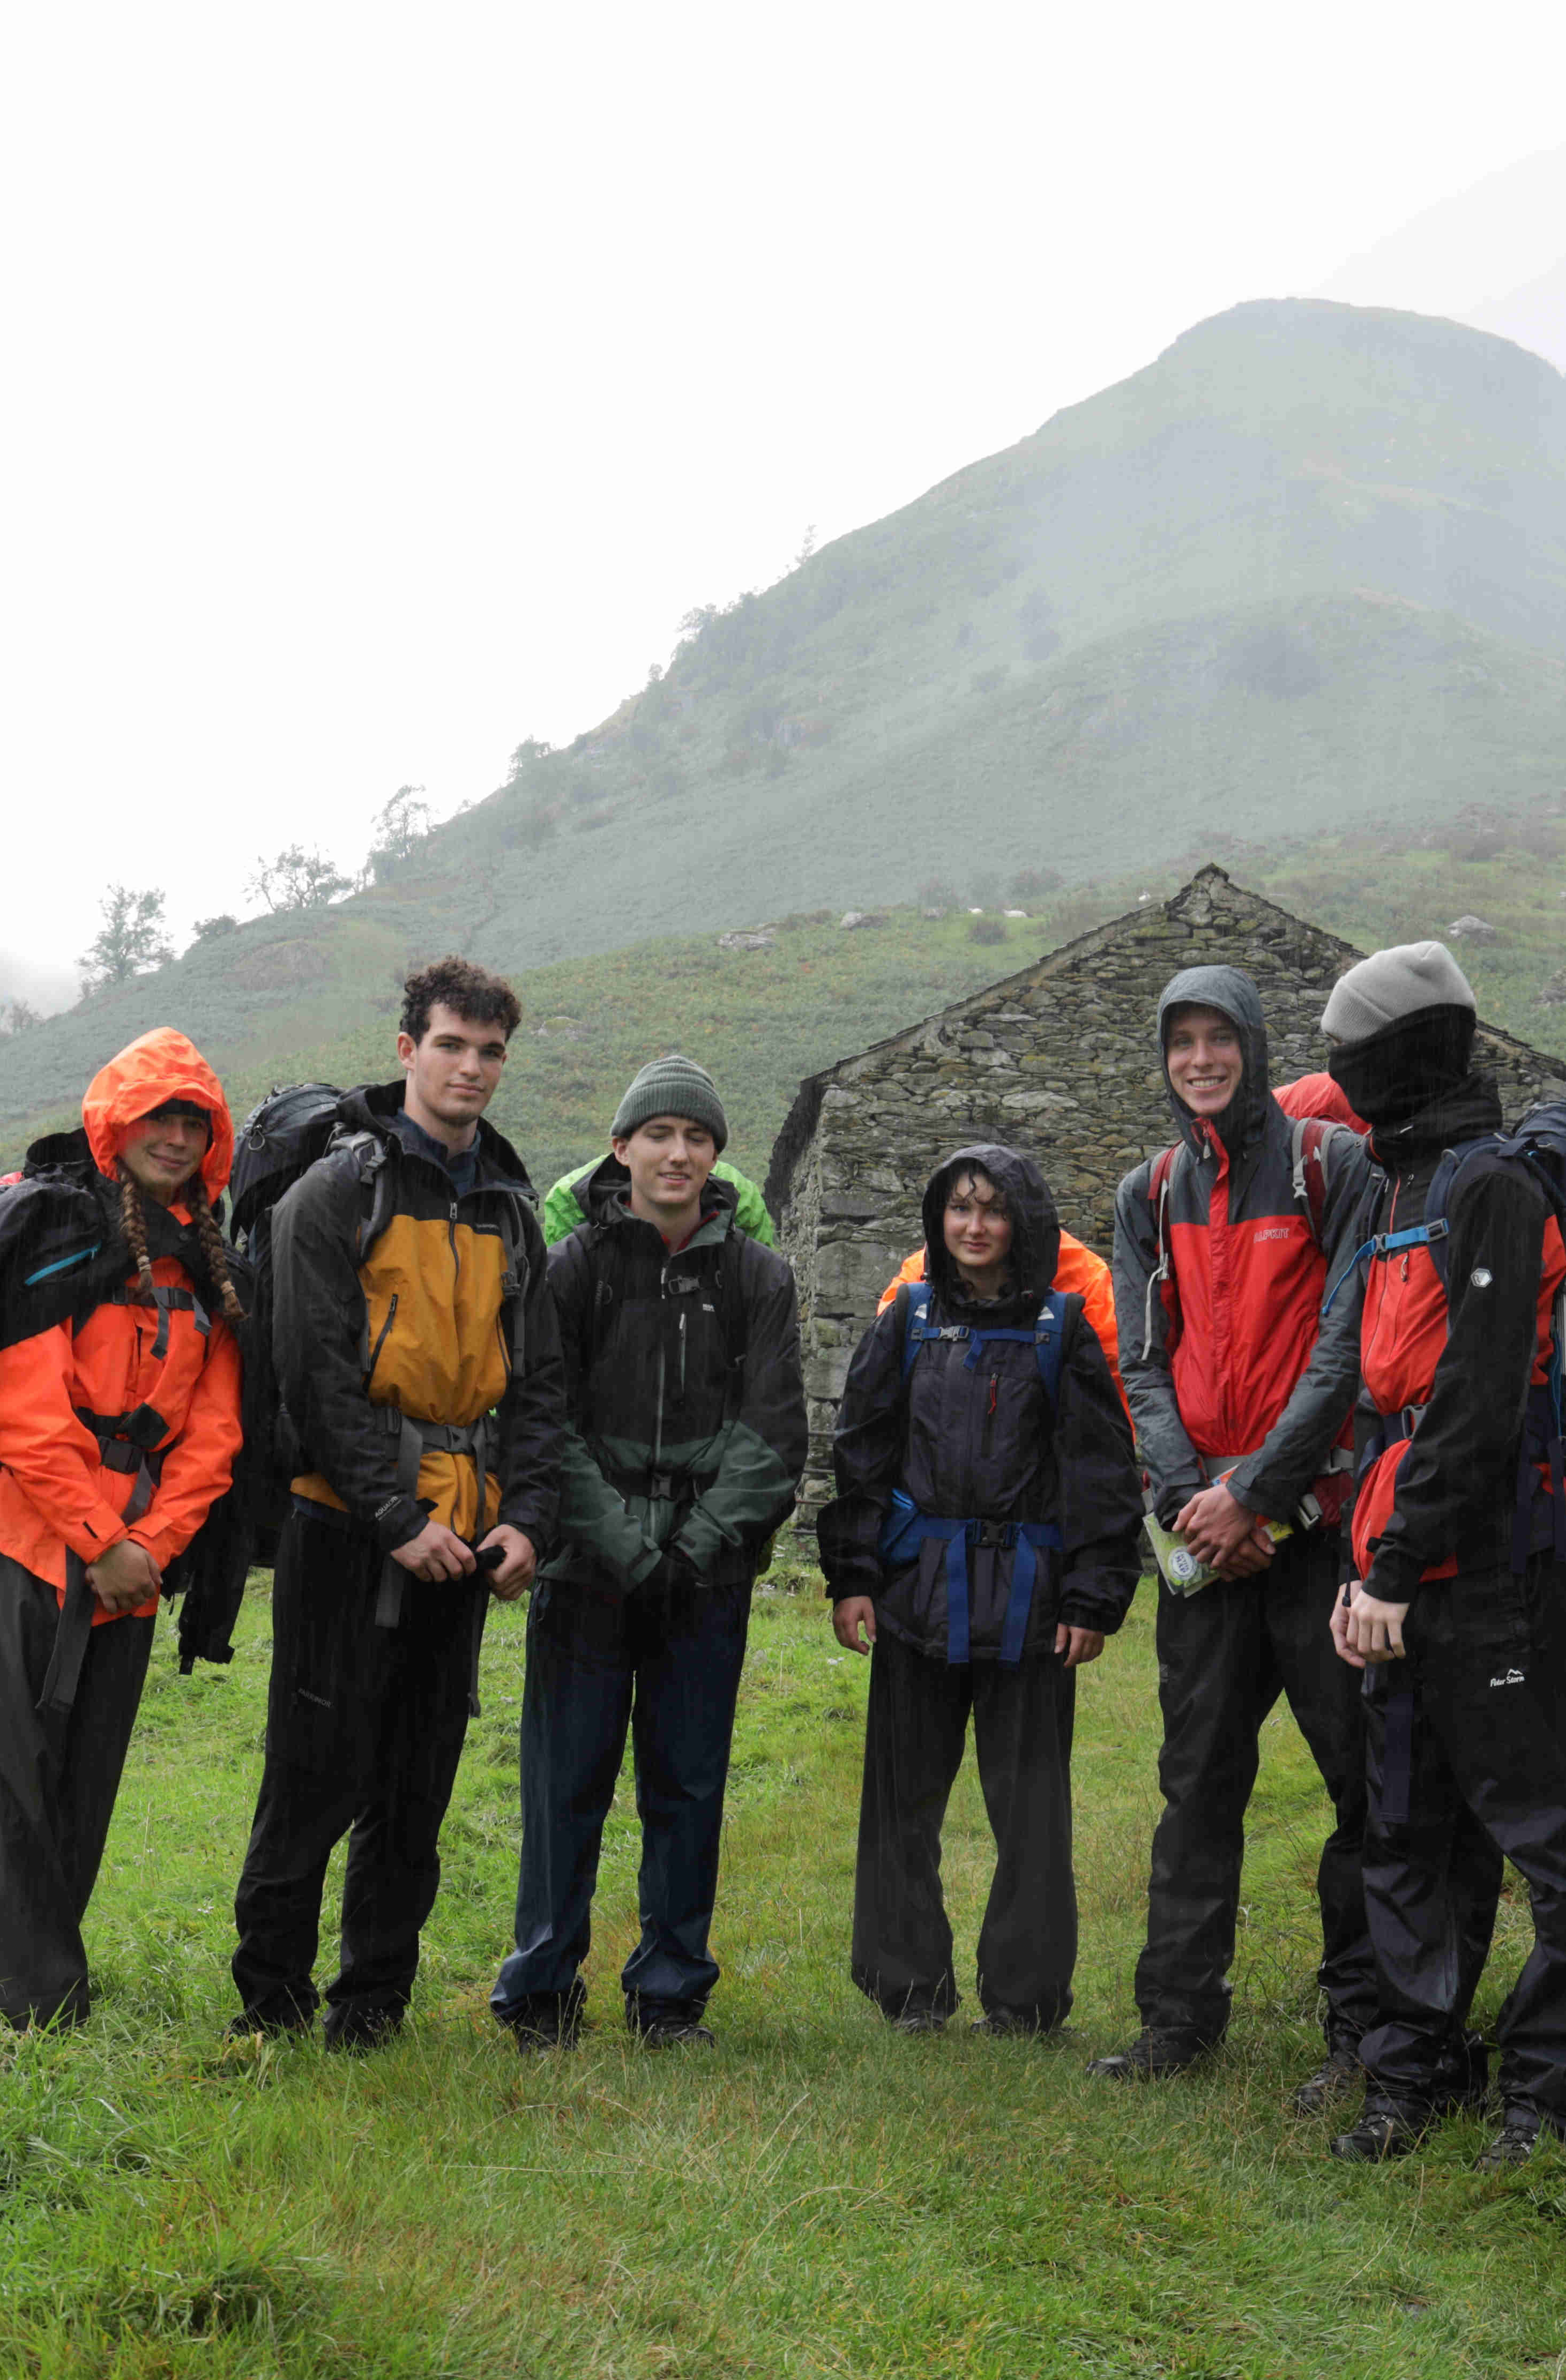
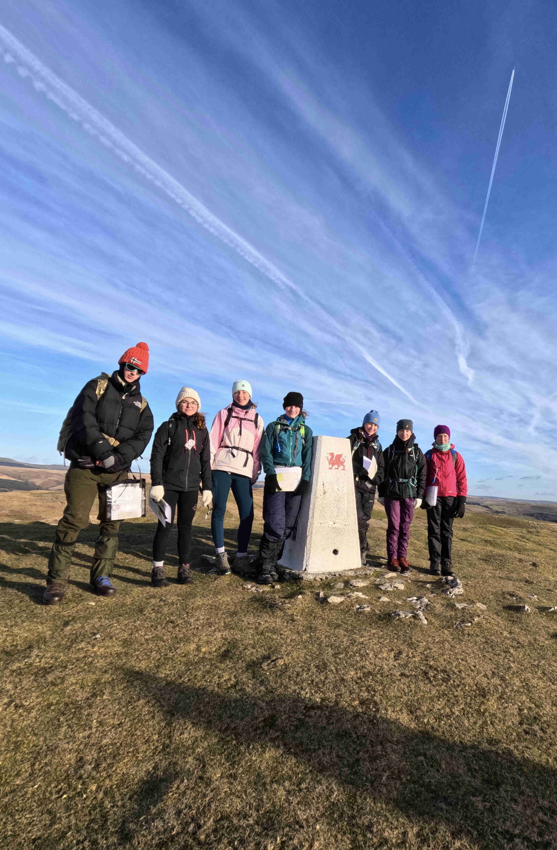
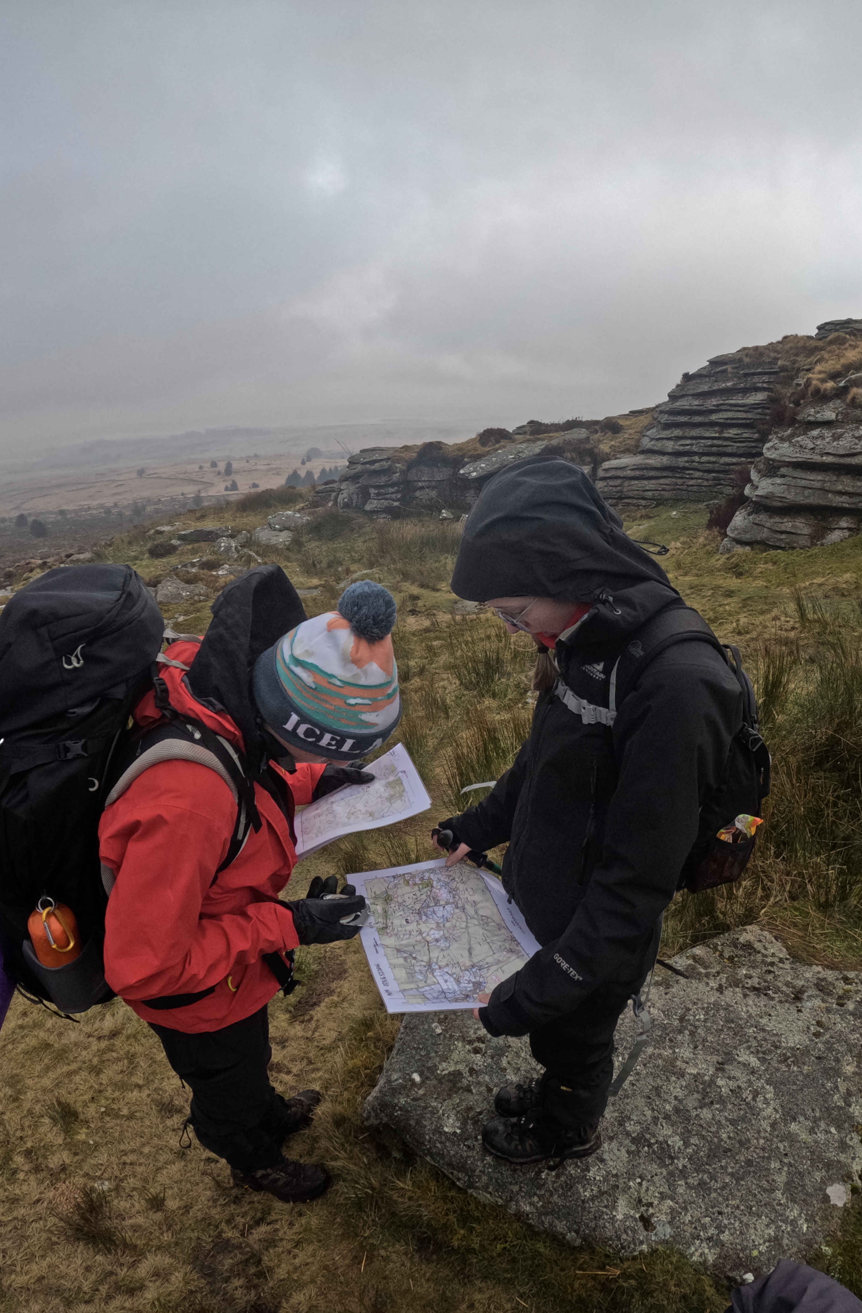
Head to the Mountains

Slide 5
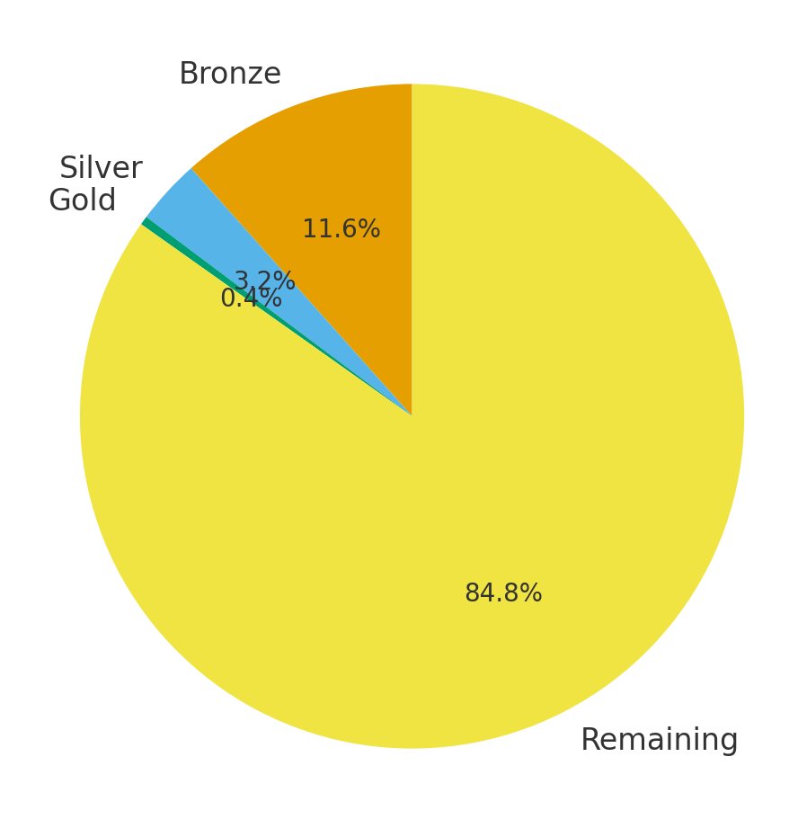
DofE helps you to stand out!
Bronze
Silver
Gold
683,000 people applied to attend university in the UK
73,719 students attained Bronze
20,081 students attained Silver
2,789 students attained Gold
University applicants without DofE

Slide 6
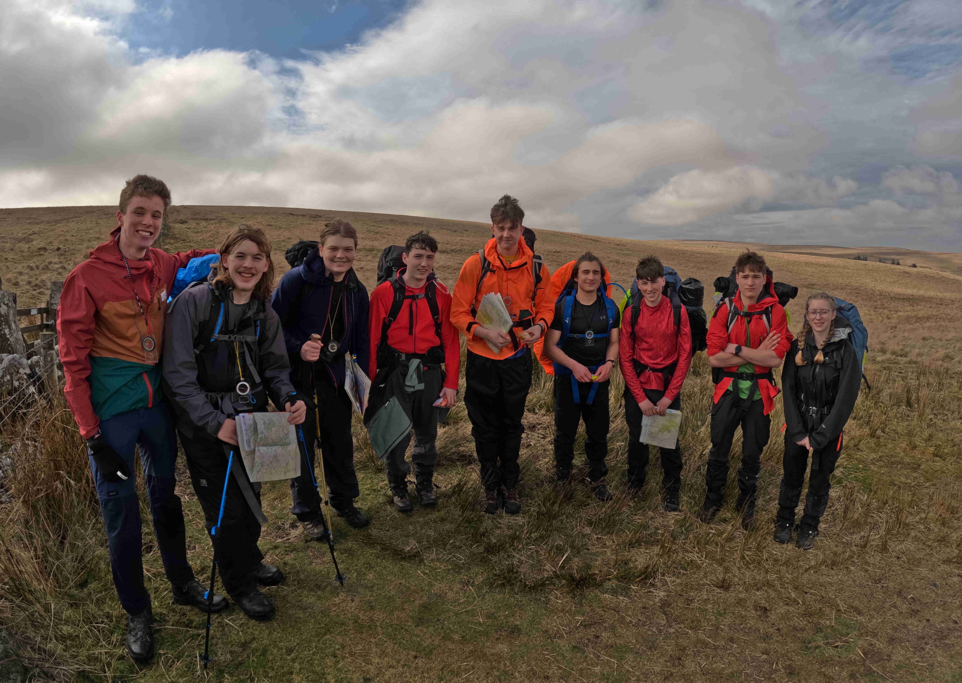
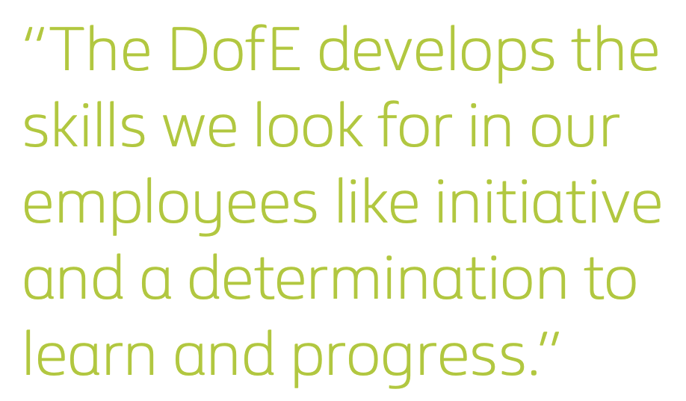

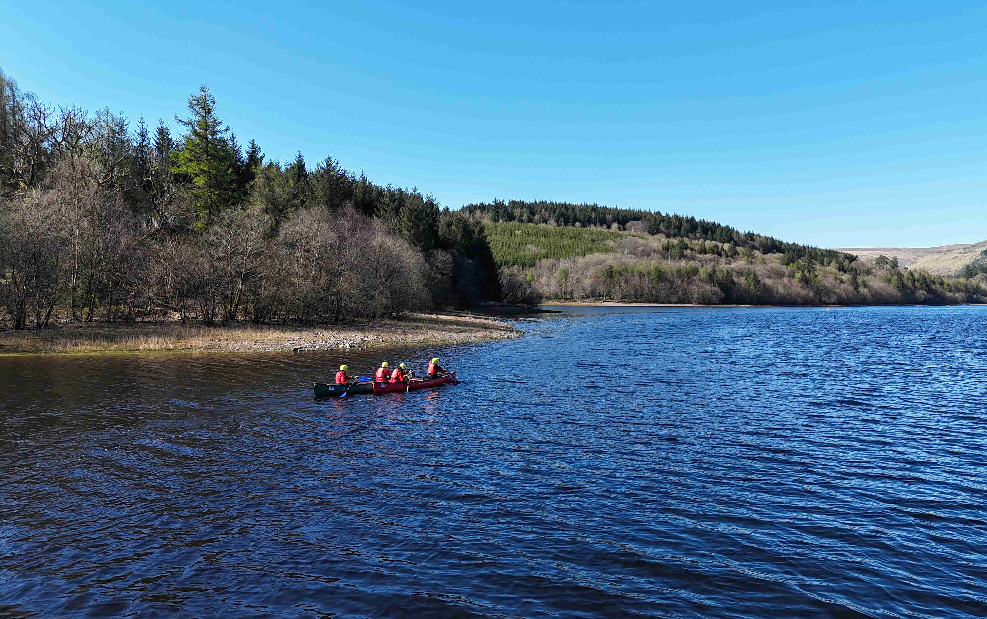

“More than 25 per cent of employers in the UK prioritise the Duke of Edinburgh’s Award.”

Slide 7
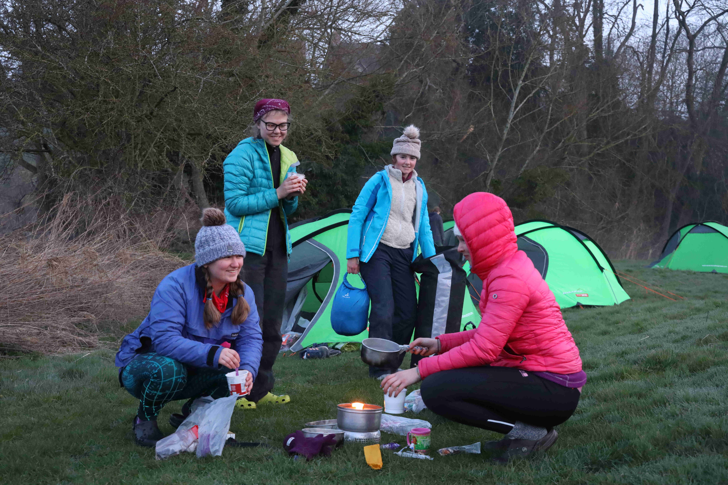
Why do DofE?
It’s fun!
You get to explore wild places
Universities and employers want more than grades
DofE helps you to:
- Solve problems
- Work effectively in a team
- Manage time

